Slide 1
Capstone Design Team F
진행 상황
2016310237 김동우
2016314577 김동한
2016311033 김영현
2017312329 최형규

Slide 2
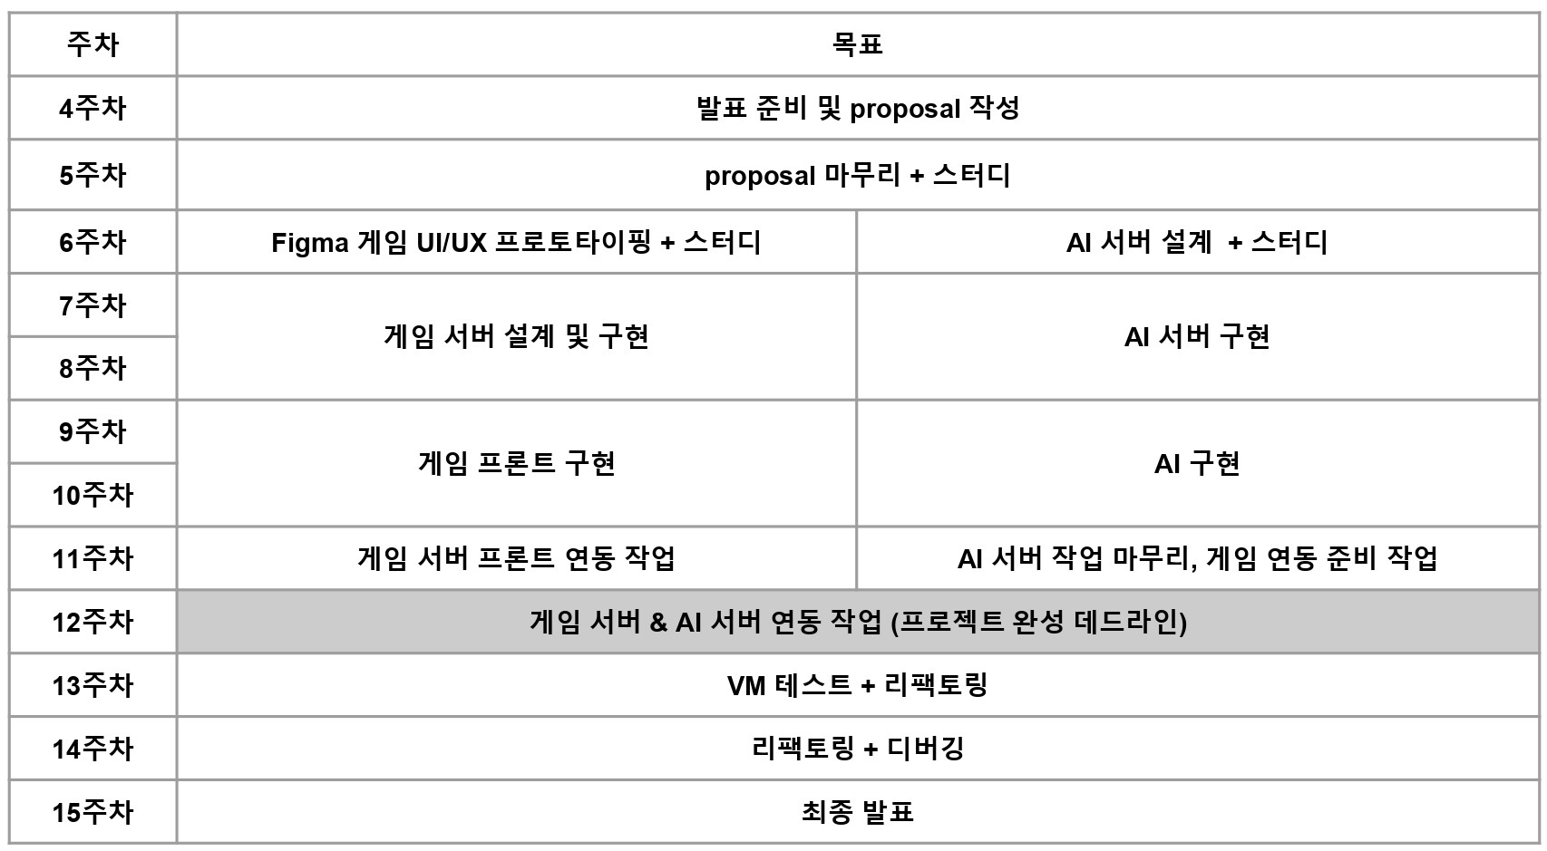
Weekly Plan

Slide 3
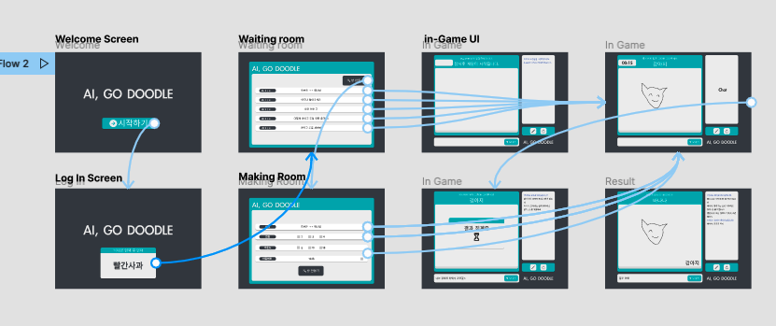
진행 상황 - UI/UX
User flow Work done

Slide 4
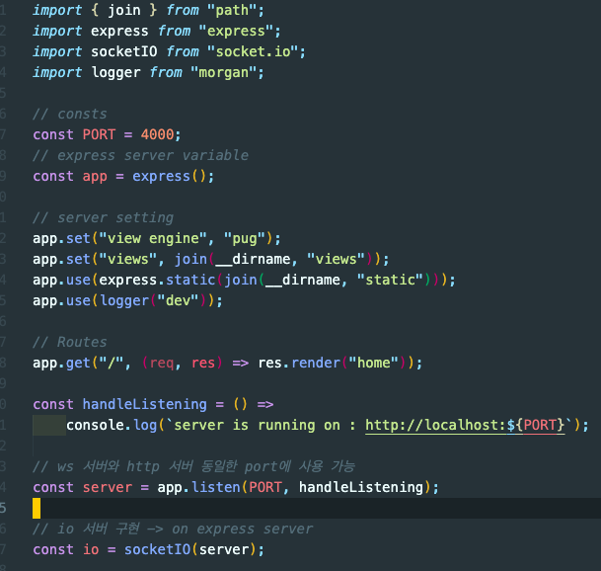
진행 상황 - Game Server
Babel set up (for ES6)
Pug template engine set up
SCSS set up
Simple Node.js http Server

Slide 5
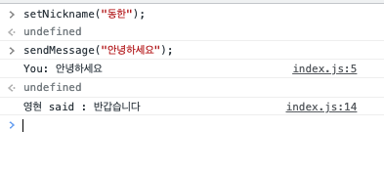
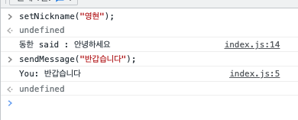
진행 상황 - Game Server
Browser 1
Communicate
Browser 2
Socket Connect Test

Slide 6
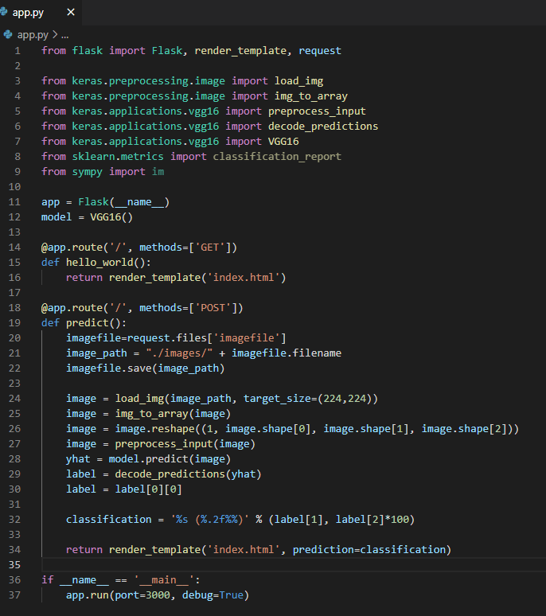
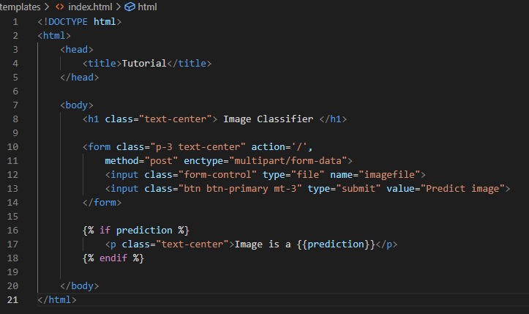
진행 상황 - A.I Server

Slide 7
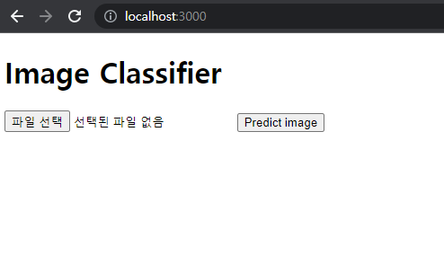
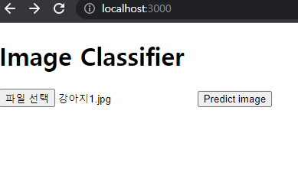
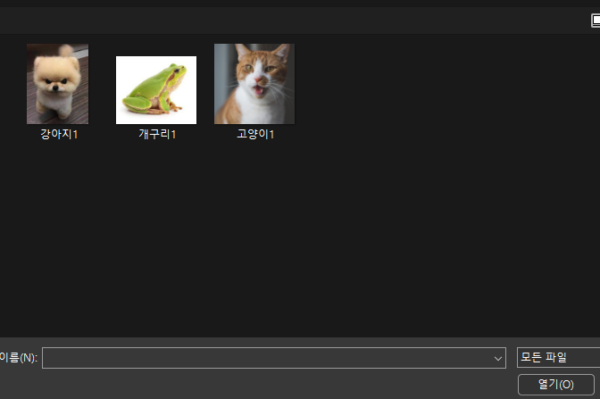
진행 상황 - A.I Server

Slide 8
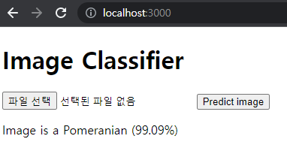
진행 상황 - A.I Server

Slide 9
Hyperparameter Test
Initialization / (class 30)
exp | data |  |  | augmentation |  |  | accuracy |  | learning info
model | class | image / class | train | resize | rotation | flip | val | test | time/epoch | batch size | initialization | criterion | optimizer | # of param
vgg19 | 30 | 2000 | 38.4K | o | x | x | 3.3 | - | 3.9min | 128 | x | Cross Entropy | Adam | 55,805,918
vgg19 | 30 | 2000 | 38.4K | o | x | x | 85.8 | 85.0 | 4.2m | 128 | kaiming (He) | Cross Entropy | Adam | 55,805,918
Kaiming (He) initialization :
- (x) : diverge
- (o) : accuracy 85%

Slide 10
Hyperparameter Test
2) Data augmentation / (class 30)
exp | data |  |  | augmentation |  |  | accuracy |  | learning info
model | class | image / class | train | resize | rotation | flip | val | test | time/epoch | batch size | initialization | criterion | optimizer | # of param
vgg19 | 30 | 2000 | 38.4K | o | x | x | 85.8 | 85.0 | 3.9min | 128 | kaiming (He) | Cross Entropy | Adam | 55,805,918
vgg19 | 30 | 2000 | 38.4K | o | o | o | 89.3 | 86.9 | 4.2m | 128 | kaiming (He) | Cross Entropy | Adam | 55,805,918
Data augmentation : Accuracy 1.9% improved

Slide 11
Hyperparameter Test
3) Batch size / class(30)
exp | data |  |  | augmentation |  |  | accuracy |  | learning info
model | class | image / class | train | resize | rotation | flip | val | test | time/epoch | batch size | initialization | criterion | optimizer | # of param
vgg19 | 30 | 2000 | 38.4K | o | x | x | 85.8 | 85.0 | 3.9min | 128 | kaiming (He) | Cross Entropy | Adam | 55,805,918
vgg19 | 30 | 2000 | 38.4K | o | x | x | 85.3 | 85.9 | 4.5m | 64 | kaiming (He) | Cross Entropy | Adam | 55,805,918
Batch size
- ( Batch 128) : accuracy 85%
- (Batch 64) : accuracy 85.9%, 0.9%improved but trivial

Slide 12
Hyperparameter Test
3) Data augmentation / class(50)
exp | data |  |  | augmentation |  |  | accuracy |  | learning info
model | class | image / class | train | resize | rotation | flip | val | test | time/epoch | batch size | initialization | criterion | optimizer | # of param
vgg19 | 30 | 2000 | 38.4K | o | x | x | 85.8 | 85.0 | 3.9min | 128 | kaiming (He) | Cross Entropy | Adam | 55,805,918
vgg19 | 50 | 3000 | 96K | o | x | x | 80.3 | 79.1 | 5.6min | 128 | kaiming (He) | Cross Entropy | Adam | 55,805,918
vgg19 | 50 | 3000 | 96K | o | o | o | 85.3 | 85.9 | 10.5m | 128 | kaiming (He) | Cross Entropy | Adam | 55,805,918
Class #
- (class 30) : accuracy 85%
- (class 50) : accuracy 79.1%
- (class 50 + Data augmentation) : accuracy 85.9 (6.8% improved!)

Slide 13
Hyperparameter Test
Conclusion)
Kaiming (He) initialization helps stable convergence
If # of classes increases, overall performance goes down
Data augmentation improves the performance
since vggnet19 has 55.8M params, overfitting is inevitable => How about vgg16?
Next experiment)
Test with vggnet16 with different hyper-params
We used data augmentation with only random rotation and flip => add scaling
To prevent overfitting, training with more data is ideal => Computational power & time increases

Slide 14
TO-DO List
Game
A.I
Communicate with Game server
test with vggnet16
test with more data
add Scaling
Routes set-up
Image file upload
Send Image to A.I Server

Slide 15
Thank you

